Slide 1


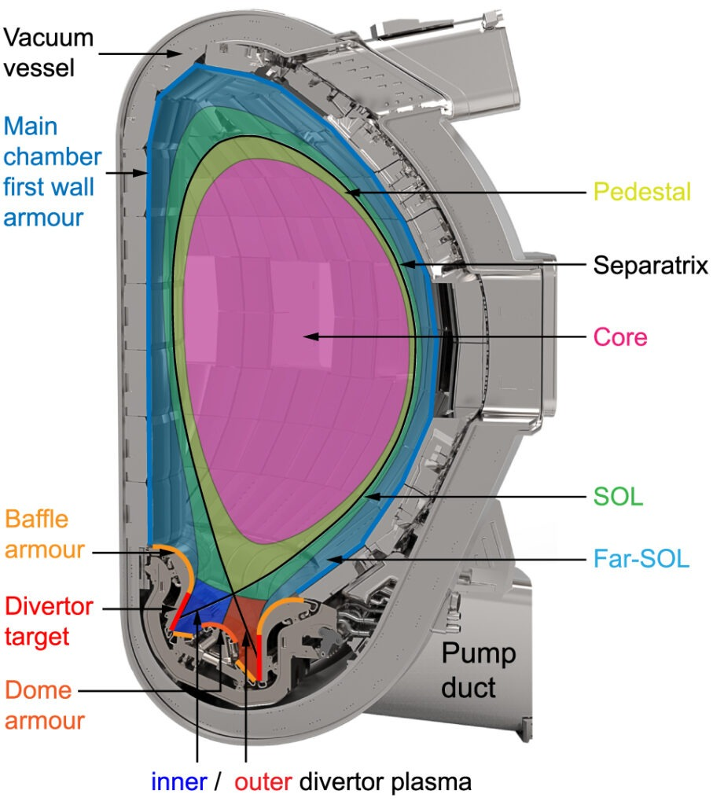
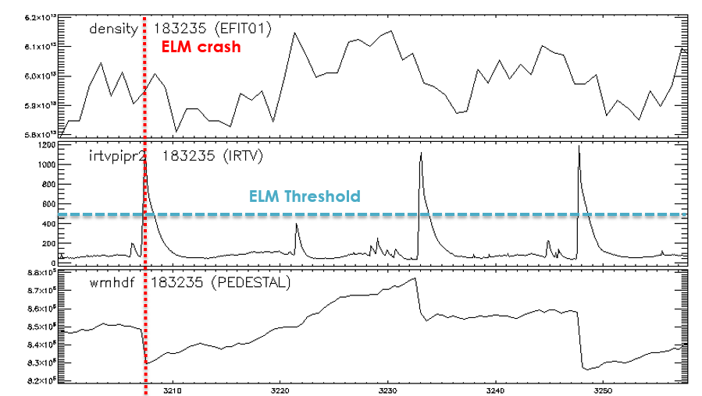
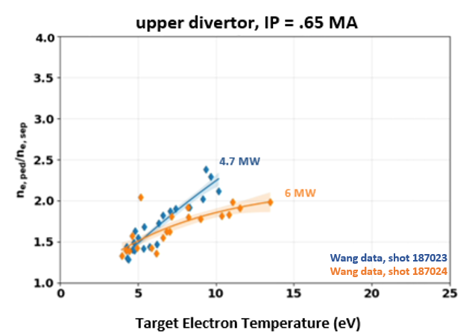
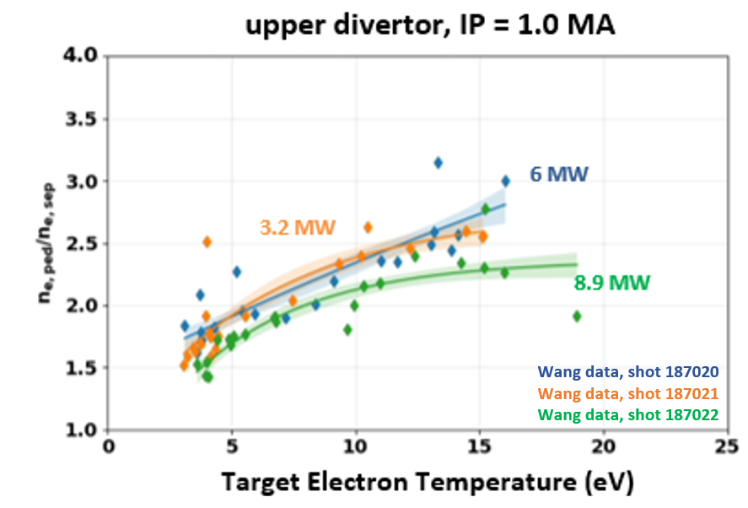


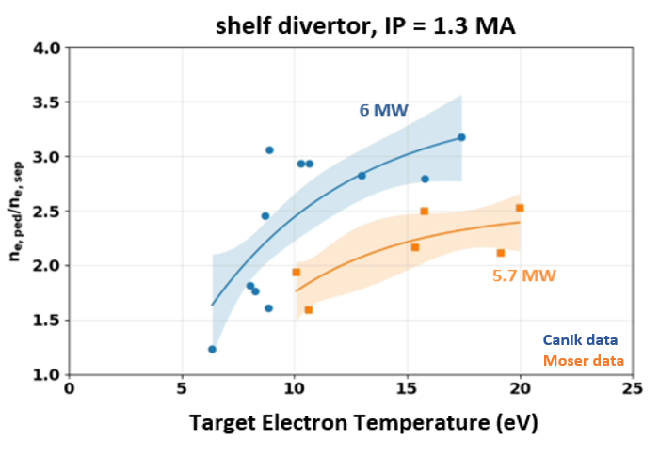
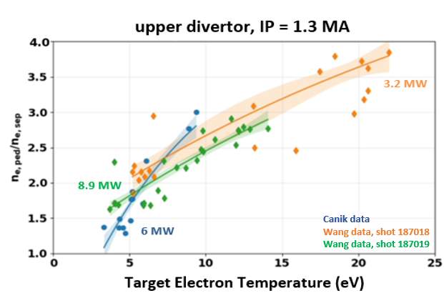
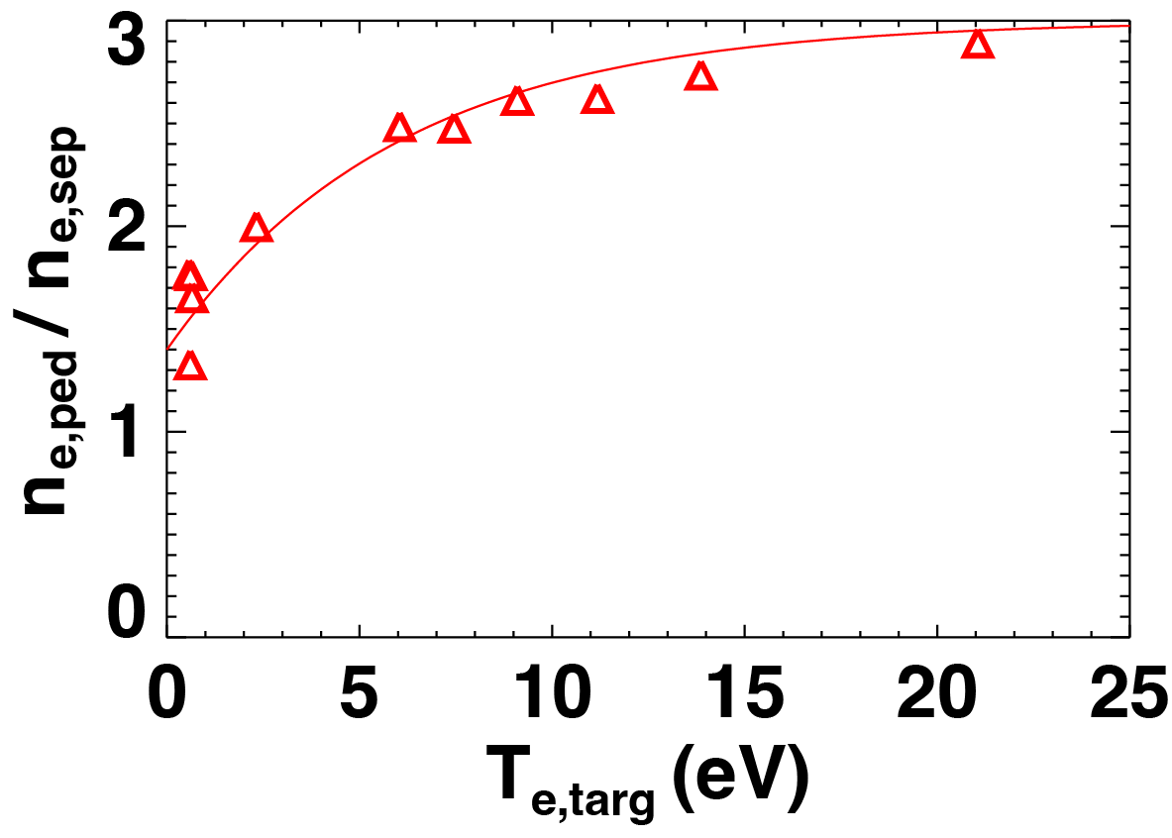
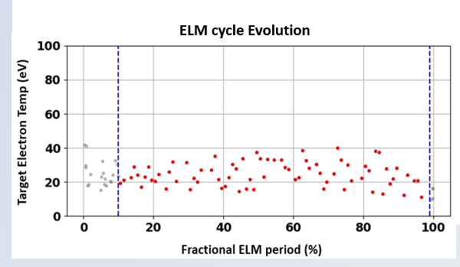
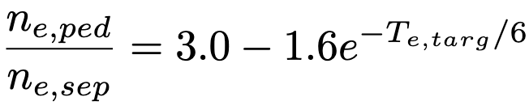
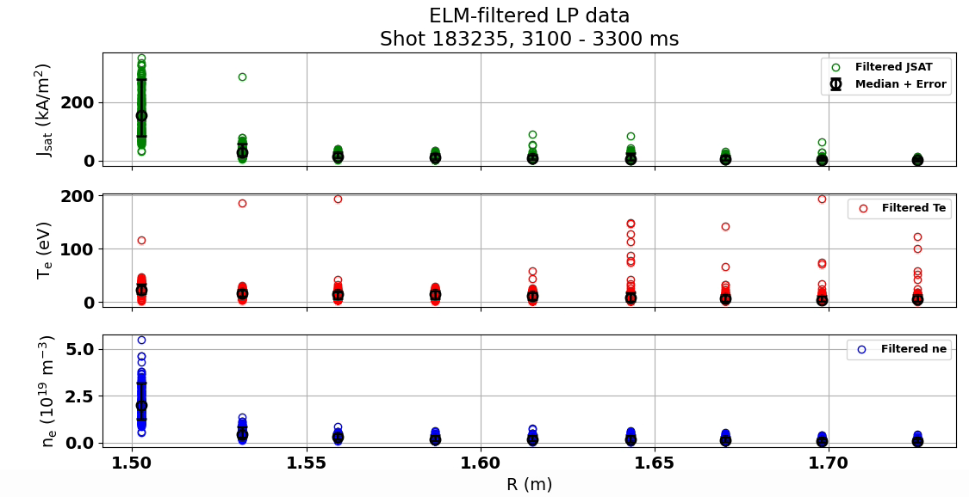
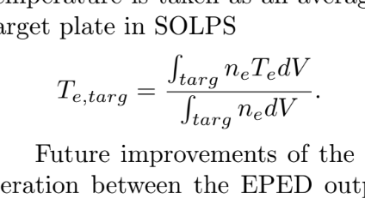
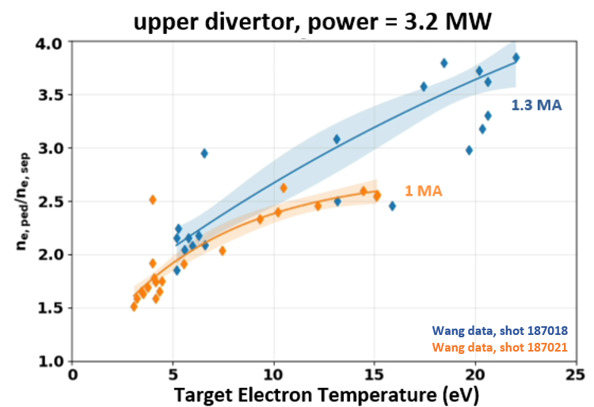
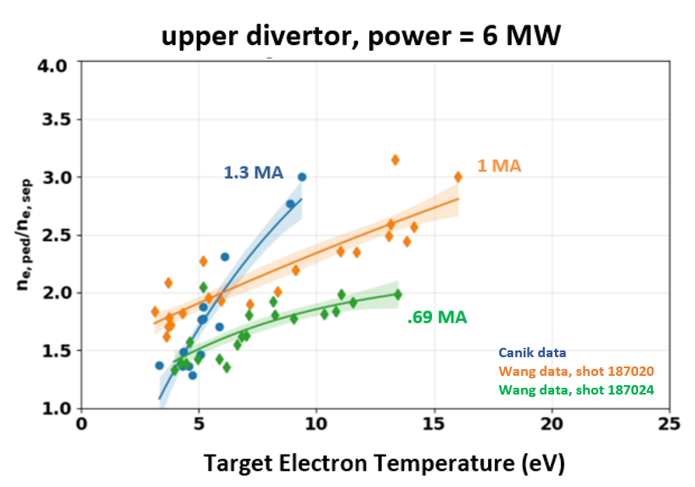
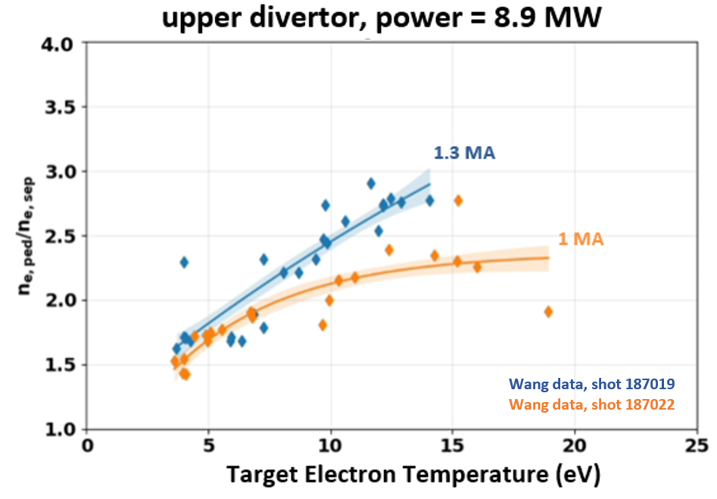
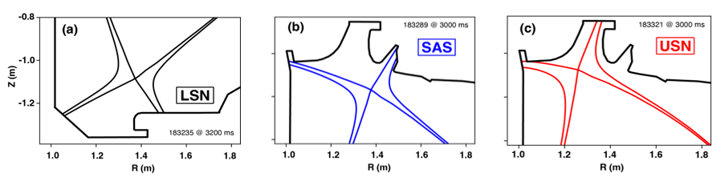
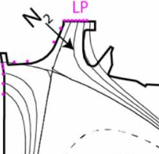
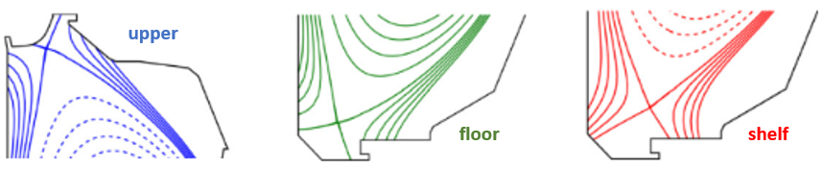
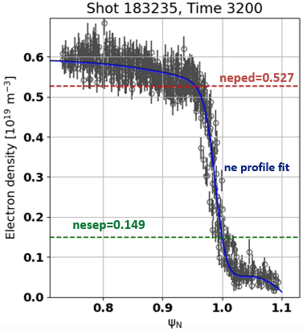
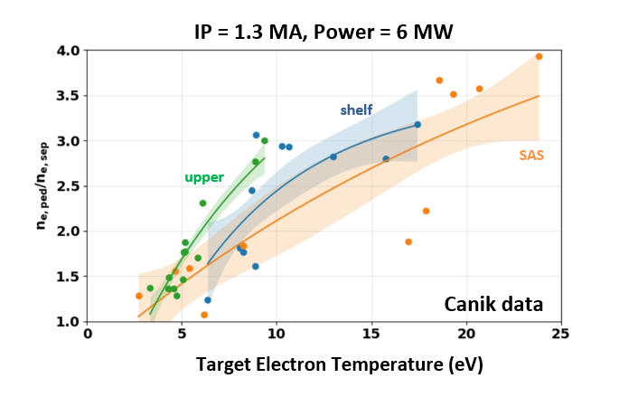
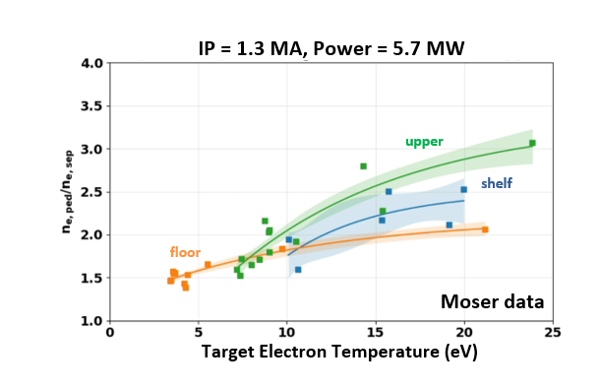
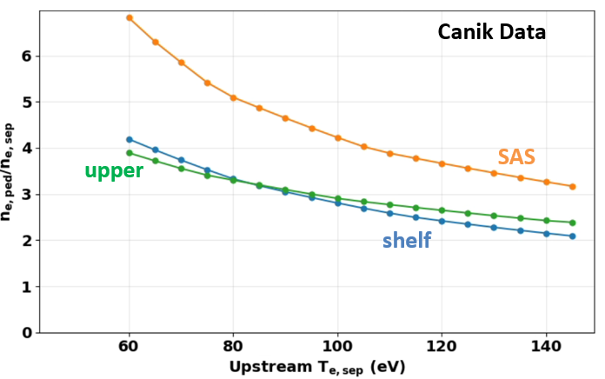
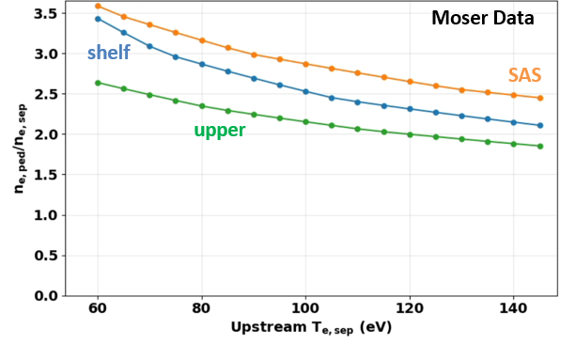

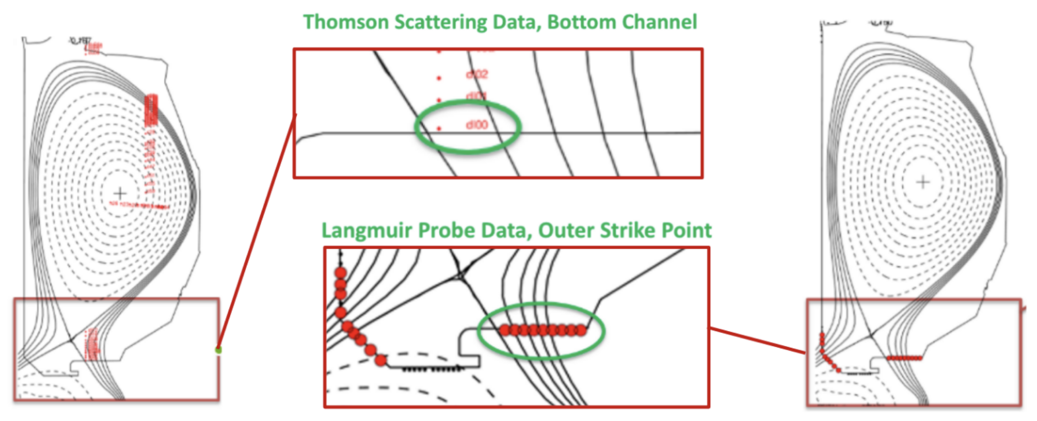
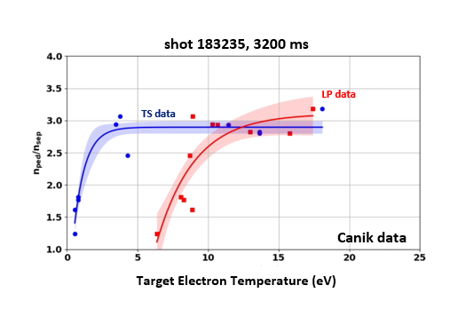
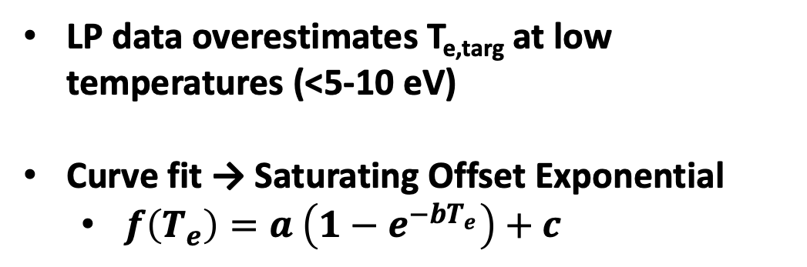
Correlating Pedestal Density Structure with Divertor Target Temperature in DIII-D
E.J.B. Dreisbach, R.S. Wilcox, J.M. Canik, F. Conti, R. Hood, A.G. McLean, A.L. Moser, T.H. Osborne, M.W. Shafer, C.K. Tsui, H.Q. Wang, T.M. Wilks
MOTIVATION & FRAMEWORK
METHODOLOGY
CORRELATION ANALYSIS & RESULTS
Background
ELM filtering
Power variation using consistent current (I_{P}) and divertor configuration
Project Goal: Investigate if there exists an empirical correlation between pedestal structure and particle Temperature at the divertor
Pedestal: narrow transport barrier that sets boundary conditions which influence core performance
n_{e,ped} → upstream density profile
Separatrix: boundary surface separating the core from the edge plasma & guides field lines to the divertor
n_{e,sep} → downstream density profile
Divertor: location on the reactor wall where all the heat and particle flux is ‘dumped’
Goal of detachment → plasma cools sufficiently before reaching the wall
T_{e,targ} → electron Temperature at the target (divertor)
Peaks included by threshold identifies ELM crashes
Core Plasma Density shows pedestal buildup, impacted by ELM crashes
ELM Peak →
Heat Flux sharp, periodic spikes correspond to ELM events
Tamás Szabolics, EUROfusion
Stored Energy recovers between ELMs, drops during each crash
Edge-core coupling: pedestal structure and divertor electron Temperature
Evolution of median temp measurements over ELM cycles informs % of data to accept
Optimal fractional period only accepts steady-state data
Consistent range of 10-99% used for this analysis
Exclude evolving temp trends → correspond to ELM come-down/build-up
Correlating pedestal density profiles with divertor electron Temperature may inform edge transport modeling & conditions for reaching detachment
LSN TS data
Key Questions:
- Does this hold across other experiments?
- Under what conditions does it change or break down?
Data averaging methods
Shots @ various input powers (~3-9 MW) fall along similar curves
Some datasets show consistent curves between variables, others diverge significantly
Experimental setup and divertor configurations
Langmuir Probe ELM filtered Profiles
LP data
Median time average
Weighted spatial average:
TS data
Weighted time average
No spatial averaging necessary
I_{P} variation using consistent power and divertor configuration
Experiment 1 – Canik Database
Towards a self-consistent EPED-SOLPS Coupled Integrated Model
Experiment 3 – Wang Database
Divertor detachment and pedestal structure in a closed Upper divertor
upper
Experiment 2 – Moser Database
Divertor closure impact on detachment and pedestal shape
Shifting the separatrix position in density profiles
n_{e,ped}/n_{e,sep} increases with current during attachment
Adjusted the flux coordinate mapping $φ_{N}$ to align with upstream TS measurements
Consistent I_{P} and power across different divertors
Sensitivity scans show density ratio dependence on T_{e,sep}
Diagnostics for determining target electron Temperature
Thomson Scattering (TS) Data, Bottom Channel
Langmuir Probe (LP) Data, Outer Strike Point
Select n_{e,sep} based on the electron temperature at the separatrix (T_{e,sep})
Sweeping from 60-140 eV in T_{e,sep} shifted the density ratio by a factor of ~2-3, depending on the divertor configuration
Future data processing refinements
Divertor geometry and plasma shape affect correlation curve
Upper divertor shows steepest ratio rise @ low T_{e,targ}
Level differs by geometry
Closed divertors → ratio >15 eV reaches ~2.5-3.5 range
Open divertors → ratio >15 eV reaches ~1.8-2.2 with a broader scatter
Power balance refinement: improved methodology for picking correct T_{e,sep} values
Broaden the datasets used (shots/experiments) and separate regimes (attached vs near-detached)
Account for plasma shape and impurity seeding
Limit data to only include probes within 1-2 heat flux from the divertor
Conclusion
LP data overestimates T_{e,targ} at low temperatures (<5-10 eV)
Curve fit → Saturating Offset Exponential
$f\left(T_{e}\right)=a \left(1−e^{−bT_{e}}\right)+c$
Acknowledgments & References
Divertor target diagnostics disagree @ low temperatures
ELM Filtering plays a minor role in data processing
Determination of the T_{e,sep} plays a significant role in the pedestal density ratio
A single, unified function does not appear to be representative of all data, or even a subset of data where individual variables are held fixed, that could be used to extrapolate a causal relationship in a predictive simulation framework.
References: R.S. Wilcox et al., Nuclear Fusion (submitted)
This work was supported in part by the US Department of Energy under DE-FC02-04ER54698, DE-AC05-00OR22725, DE-AC52-07NA27344, DE-NA0003525, and DE-SC0023378.

